Slide 1
Deep Transfer Learning and Multi-task Learning
Concepts are ensembled from various online sources with a great acknowledgement to all those made them available online.

Slide 2
Transfer Learning
Transfer a model trained on source data A to target data B
Task transfer: in this case, the source and target data can be the same
Image classification -> image segmentation
Machine translation -> sentiment analysis
Time series prediction -> time series classification
…
Data transfer:
Images of everyday objects -> medical images
Chinese -> English
Physiological signals of one patient -> another patient
…
Rationale: similar feature can be useful in different tasks, or shared by different yet related data.

Slide 3
Taxonomy of Transfer Learning
 |  | Source Data
 |  | Labeled | Unlabeled
Target Data | Labeled | Model fine-tuning Multi-task learning | Self-taught learning
 | Unlabeled | Domain-adversarial training Zero-shot learning | Self-taught clustering
Hongyi Li, Transfer Learning. https://speech.ee.ntu.edu.tw/~tlkagk/courses/ML_2016/Lecture/transfer%20(v3).pdf.

Slide 4
Taxonomy of Transfer Learning
 |  | Target Data
 |  | Labeled | Unlabeled
Source Data | Labeled | Model fine-tuning Multi-task learning | Self-taught learning
 | Unlabeled | Domain-adversarial training Zero-shot learning | Self-taught clustering
Hongyi Li, Transfer Learning. https://speech.ee.ntu.edu.tw/~tlkagk/courses/ML_2016/Lecture/transfer%20(v3).pdf.

Slide 5
Taxonomy of Transfer Learning
 |  | Target Data
 |  | Labeled | Unlabeled
Source Data | Labeled | Model fine-tuning Multi-task learning | Self-taught learning
 | Unlabeled | Domain-adversarial training Zero-shot learning | Self-taught clustering
Hongyi Li, Transfer Learning. https://speech.ee.ntu.edu.tw/~tlkagk/courses/ML_2016/Lecture/transfer%20(v3).pdf.

Slide 6
Model Fine Tuning
For a model trained on a large amount of labeled source data, transfer it to target data with very little labeled target data. E.g.
Idea: Pre-train a model using labeled source data, then fine-tune the model with labeled target data.
Caution: Do NOT overfit the limited amount of labeled target data!
Application | Source Data | Target Data
Medical image segmentation | Segmentations of many images of daily scenes | Segmentations of several medical images
Speech recognition | Audio data and transcriptions of many historical speaker | Limited audio data and transcriptions of a new speaker
Arrhythmia detection | Very-long ECG signals of a large number of historical patients | ECG snippet from a new patient
Hongyi Li, Transfer Learning. https://speech.ee.ntu.edu.tw/~tlkagk/courses/ML_2016/Lecture/transfer%20(v3).pdf.

Slide 7
Conservative Training
Output Layer
Output Layer
Hidden Layers
Hidden Layers
Use parameters of pre-trained model to initialize the parameters of the new model;
Further train the new model on target data. Limit the number of epochs to avoid over-fitting!
Input Layer
Input Layer
Source Data
Target Data
Hongyi Li, Transfer Learning. https://speech.ee.ntu.edu.tw/~tlkagk/courses/ML_2016/Lecture/transfer%20(v3).pdf.

Slide 8
Layer Transfer
Output Layer
Output Layer
Hidden Layer 3
Hidden Layer 3
Use parameters of pre-trained model to initialize the parameters of the new model;
Freeze the parameters of some hidden layers; only fine-tune parameters of other layers on target data. Limit the number of epochs to avoid over-fitting!
Usually, freeze the first or last few layers.
Hidden Layer 2
Hidden Layer 2 (Freeze!)
Hidden Layer 1
Hidden Layer 1 (Freeze!)
Input Layer
Input Layer
Source Data
Target Data
Hongyi Li, Transfer Learning. https://speech.ee.ntu.edu.tw/~tlkagk/courses/ML_2016/Lecture/transfer%20(v3).pdf.

Slide 9
Open-source Pre-trained Models
Using open-source pre-trained models for transfer learning is an effective and efficient way to acquire high-quality deep learning results for your applications!
Pre-trained Models for Natural Language Processing (NLP)
BERT
GPT-3
…
Pre-trained Models for Computer Vision (CV)
VGG-16
ResNet50
ViT
…

Slide 10
BERT: Bidirectional Encoder Representations from Transformers
A natural language processing model proposed by Google in 2018;
pre-trained on 2,500 million words of Wikipedia and 800 million words of Book Corpus;
allows for training customized question answering models in a few hours in using a single GPU;
available at https://github.com/google-research/bert.
Variants: CodeBERT, RoBERTa, ALBERT, XLNet, …

Slide 11
GPT-3: Generative Pre-trained Transformer 3
A natural language processing model proposed by OpenAI in 2020;
trained on 175 billion parameters, which is 10 times more than any previous non-sparse language model available;
strong at tasks such as translation, answering questions, as well as on-the-fly reasoning-based tasks like unscrambling words
has been applied to writing news, generating codes…
available at https://openai.com/api/.

Slide 12
VGG-16
A computer vision model proposed by the Visual Geometry Group from Oxford;
pre-trained on the ImageNet corpus; first runner-up of ILSVRC (ImageNet Large Scale Visual Recognition Competition) 2014 in the classification task
a CNN model with 16 layers and about 138 million parameters;
has been built into popular deep learning frameworks such as PyTorch and Keras.
Variant: VGG-19

Slide 13
ResNet50
A variant of the ResNet model, a computer vision model proposed by Microsoft in 2015;
pre-trained on the ImageNet corpus;
a CNN model with 50 layers and about 380 million parameters;
has been built into popular deep learning frameworks such as PyTorch and Keras.

Slide 14
ViT: Vision Transformer
A computer vision (CV) model proposed by Google in 2020;
introduces the Transformer architecture, which has achieved huge success in natural language processing, into CV; the idea is treating patches in images as words in text;
can achieve better accuracy and efficiency than CNNs such as ResNet50;
available at https://github.com/google-research/vision_transformer.
Variants: Swin Transformer, PVTv2…

Slide 15
Taxonomy of Transfer Learning
 |  | Target Data
 |  | Labeled | Unlabeled
Source Data | Labeled | Model fine-tuning Multi-task learning | Self-taught learning
 | Unlabeled | Domain-adversarial training Zero-shot learning | Self-taught clustering
Hongyi Li, Transfer Learning. https://speech.ee.ntu.edu.tw/~tlkagk/courses/ML_2016/Lecture/transfer%20(v3).pdf.

Slide 16
Multi-task Learning (MTL)
Simultaneously undertaking multiple tasks using a single network. E.g.
Simultaneous ECG heartbeat segmentation and classification
…
We do not necessarily need multiple main tasks. Rather, we can have one main task and several auxiliary tasks to support the main task.
Domain adaptation
Self-supervision
….
Basic forms of MTL: hard or soft parameter sharing.

Slide 17
Hard Parameter Sharing
Different tasks share some layers (i.e. the parameters of these layers), usually used for feature extraction for input data.
The output of the shared layers (usually learned features) is fed to different task-specific layers to obtain the final results.
Output Layer (Task A)
Output Layer (Task B)
Task-specific layers
(Task A)
Task-specific layers
(Task A)
Task-specific layers
(Task B)
Shared Layers
(Feature Extractor)
Input Layer (Tasks A & B)
Input Layer (Tasks A & B)
Sebastian Ruder, An Overview of Multi-Task Learning in Deep Neural Networks. https://ruder.io/multi-task/.

Slide 18
Soft Parameter Sharing
Replace shared layers (with identical parameters) with constrained layers, which have similar or related parameters.
The similarity or relatedness of parameters than can be controlled by a regularization term in the loss function, or through connections between constrained layers of different tasks.
Output Layer (Task A)
Output Layer (Task B)
Unconstrained layers
(Task A)
Unconstrained layers
(Task B)
Constrained Layers
(Task A)
Constrained Layers
(Task B)
Input Layer (Task A)
Input Layer (Task B)
Sebastian Ruder, An Overview of Multi-Task Learning in Deep Neural Networks. https://ruder.io/multi-task/.

Slide 19
Why does MTL work?
Implicit data augmentation:
If different tasks have different input data, then each task can benefit from the extra knowledge encoded in the input of other tasks.
Even if all tasks share the same data, simultaneously learning for multiple tasks can reduce the risk of overfitting for each one of these tasks.
Enhanced feature learning
It may be the case that a specific task is so noisy that we cannot learn the most relevant features if we only deal with that particular task.
Including other tasks makes it easier to uncover truly relevant features.
Besides, some features are easier to learn for some tasks than others. Handling all tasks together can help enhance the latter’s performance.
Sebastian Ruder, An Overview of Multi-Task Learning in Deep Neural Networks. https://ruder.io/multi-task/.

Slide 20
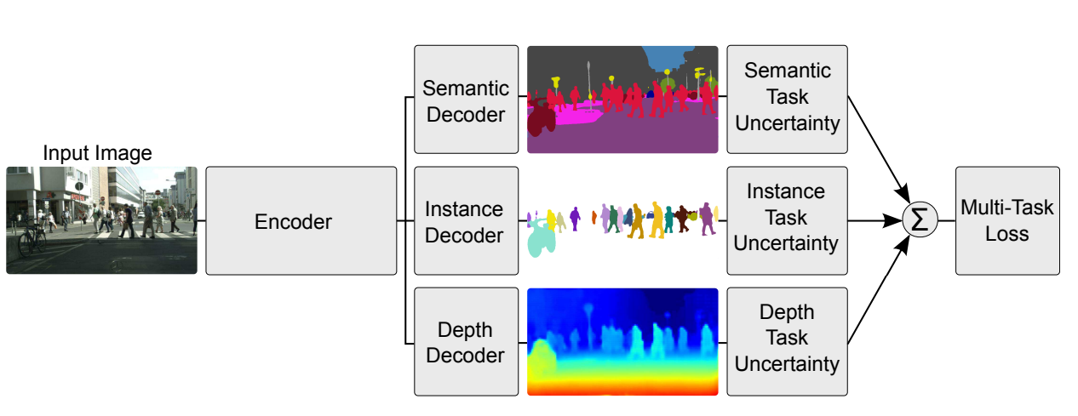
MTL-Example: Image Segmentation and Depth Regression
Fusing semantic segmentation, instance segmentation and per-pixel depth regression tasks using hard parameter sharing.
Kendall, Alex, Yarin Gal, and Roberto Cipolla. "Multi-task learning using uncertainty to weigh losses for scene geometry and semantics." Proceedings of the IEEE conference on computer vision and pattern recognition. 2018.

Slide 21
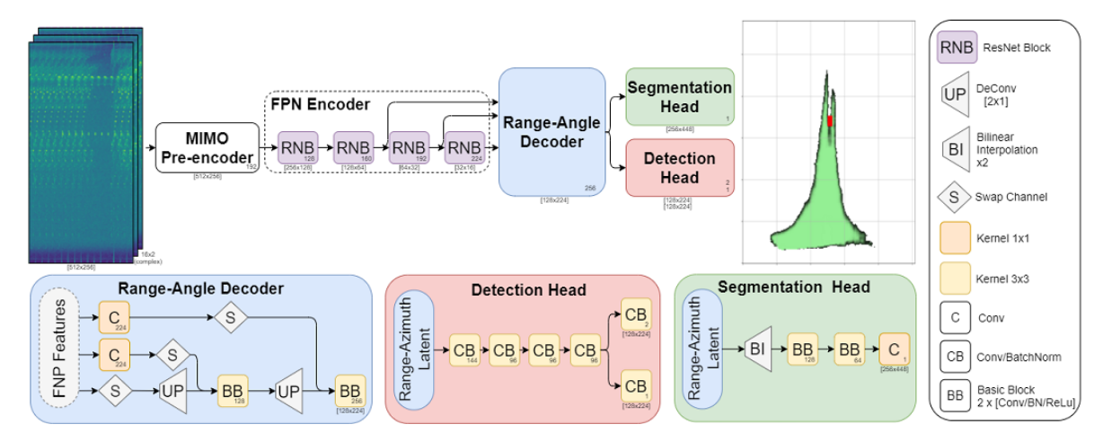
MTL-Example: High-definition Radar
Fusing vehicle detection and free-space segmentation tasks by hard parameter sharing.
Rebut, Julien, et al. "Raw High-Definition Radar for Multi-Task Learning." Proceedings of the IEEE/CVF Conference on Computer Vision and Pattern Recognition. 2022.

Slide 22
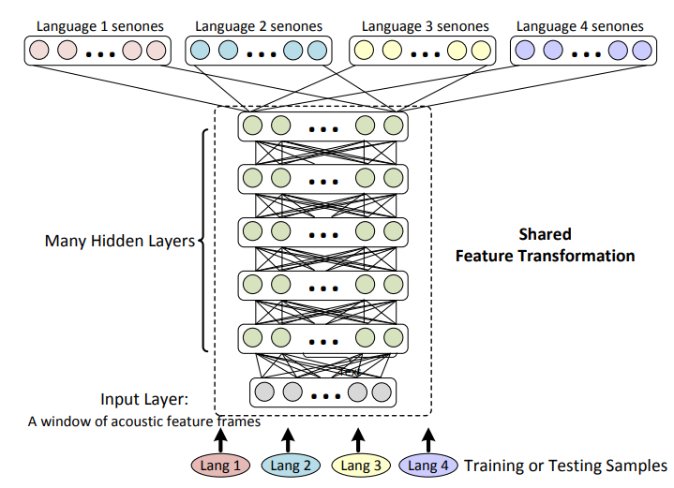
MTL Example: Cross Language Knowledge Transfer
Fusing language-specific tasks using multi-lingual feature transformation layers by hard parameter sharing.
Huang, Jui-Ting, et al. "Cross-language knowledge transfer using multilingual deep neural network with shared hidden layers." 2013 IEEE International Conference on Acoustics, Speech and Signal Processing. IEEE, 2013.

Slide 23
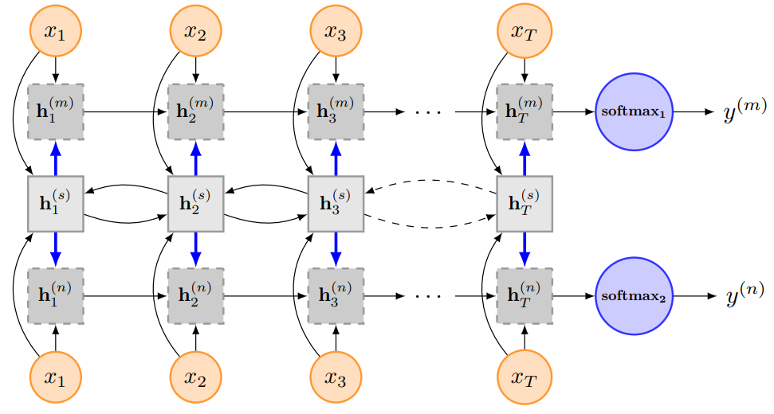
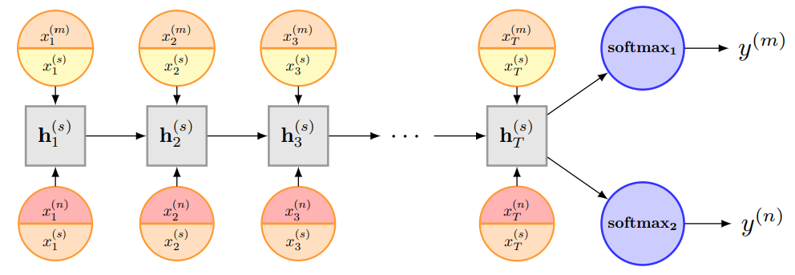
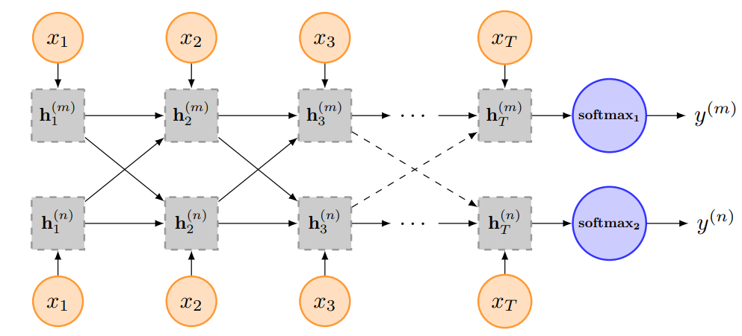
MTL Example: Text Classification
Hard parameter sharing: one shared LSTM
Hard & soft parameter sharing: two constrained LSTMs connected by one shared bi-LSTM
Soft parameter sharing: two constrained LSTMs with connections
Liu, Pengfei, Xipeng Qiu, and Xuanjing Huang. "Recurrent neural network for text classification with multi-task learning." arXiv preprint arXiv:1605.05101 (2016).

Slide 24
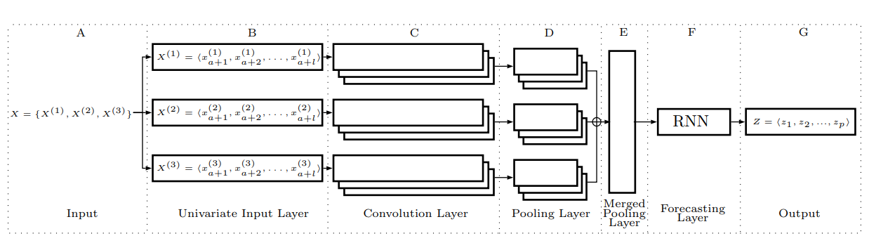
MTL Example: Correlated Time Series Forecasting
Fusing task-specific layers using shared layers by hard parameter sharing.
Cirstea, Razvan-Gabriel, et al. "Correlated time series forecasting using multi-task deep neural networks." Proceedings of the 27th acm international conference on information and knowledge management. 2018.

Slide 25
References
Hongyi Li, Transfer Learning. https://speech.ee.ntu.edu.tw/~tlkagk/courses/ML_2016/Lecture/transfer%20(v3).pdf.
Sejuti Das. Top 8 Pre-Trained NLP Models Developers Must Know. https://analyticsindiamag.com/top-8-pre-trained-nlp-models-developers-must-know/.
Devlin, Jacob, et al. "Bert: Pre-training of deep bidirectional transformers for language understanding." arXiv preprint arXiv:1810.04805 (2018).
Brown, Tom, etFeng, Zhangyin, et al. "Codebert: A pre-trained model for programming and natural languages." arXiv preprint arXiv:2002.08155 (2020). al. "Language models are few-shot learners." Advances in neural information processing systems 33 (2020): 1877-1901.
Liu, Yinhan, et al. "Roberta: A robustly optimized bert pretraining approach." arXiv preprint arXiv:1907.11692 (2019).
Lan, Zhenzhong, et al. "Albert: A lite bert for self-supervised learning of language representations." arXiv preprint arXiv:1909.11942 (2019).
Yang, Zhilin, et al. "Xlnet: Generalized autoregressive pretraining for language understanding." Advances in neural information processing systems 32 (2019).
Simonyan, Karen, and Andrew Zisserman. "Very deep convolutional networks for large-scale image recognition." arXiv preprint arXiv:1409.1556 (2014).
He, Kaiming, et al. "Deep residual learning for image recognition." Proceedings of the IEEE conference on computer vision and pattern recognition. 2016.
Dosovitskiy, Alexey, et al. "An image is worth 16x16 words: Transformers for image recognition at scale." arXiv preprint arXiv:2010.11929 (2020).
Liu, Ze, et al. "Swin transformer: Hierarchical vision transformer using shifted windows." Proceedings of the IEEE/CVF International Conference on Computer Vision. 2021.
Wang, Wenhai, et al. "Pvt v2: Improved baselines with pyramid vision transformer." Computational Visual Media 8.3 (2022): 415-424.

Slide 26
References
Sebastian Ruder, An Overview of Multi-Task Learning in Deep Neural Networks. https://ruder.io/multi-task/.
Kendall, Alex, Yarin Gal, and Roberto Cipolla. "Multi-task learning using uncertainty to weigh losses for scene geometry and semantics." Proceedings of the IEEE conference on computer vision and pattern recognition. 2018.
Rebut, Julien, et al. "Raw High-Definition Radar for Multi-Task Learning." Proceedings of the IEEE/CVF Conference on Computer Vision and Pattern Recognition. 2022.
Huang, Jui-Ting, et al. "Cross-language knowledge transfer using multilingual deep neural network with shared hidden layers." 2013 IEEE International Conference on Acoustics, Speech and Signal Processing. IEEE, 2013.
Liu, Pengfei, Xipeng Qiu, and Xuanjing Huang. "Recurrent neural network for text classification with multi-task learning." arXiv preprint arXiv:1605.05101 (2016).
Cirstea, Razvan-Gabriel, et al. "Correlated time series forecasting using multi-task deep neural networks." Proceedings of the 27th acm international conference on information and knowledge management. 2018.

